Slide 1
Business Intelligence and Business Analytics (H9BIBA)

Slide 2
Today
Consumer Behaviour models
Behaviourist v Cognitivist, Lawson’s, EKB, and Howard and Sheth’s models

Slide 3
Behaviorism
Behaviorism is a school of thought in psychology which believes that all things that organisms do including acting, thinking and feeling can and should be regarded as behaviors.
Behaviors can be measured, trained, and changed.
Behaviorism was established with the publication of Watson’s classic paper “Psychology as the Behaviorist Views it (1913)”
https://psychclassics.yorku.ca/Watson/views.htm
From about 1920 through the mid-1950s, behaviors grew to become the dominant force within psychology.
Behaviorism vs. Cognitivism montserrat Donoso 2014

Slide 4
Cognition
Cognition is a group of mental actions or processes that includes attention, memory, producing and understanding language, learning, reasoning, problem solving, and decision making.
Simply, it is a model for how the mind learns new things.
Cognitivism is known as a view that the mind is basically a computer with the ability to process and store things.
People believe that the brain takes in information, analyzes it, stores it, and uses it.
Behaviorism vs. Cognitivism montserrat Donoso 2014

Slide 5
Cognition continue …
When people discuss the theory, they often use computer-based metaphors.
Cognitivism became popular in the 1950s, and it competes with the rival learning theories known as behaviourism and constructivism.
Behaviorism vs. Cognitivism montserrat Donoso 2014

Slide 6
Cognition continue …
When teachers try to use cognitivism in the classroom, they often focus on putting things into a useful context for students. This is thought to be important because the mind may store the information differently if people learn it in a different context.
For example, if someone learns how to add in an abstract way, the mind may see that as a simple mental trick.
On the other hand, if a person learns to add in relation to something useful in everyday life, such as a transaction scenario, for example, he might be able to more readily access that knowledge when he needs it.
Behaviorism vs. Cognitivism montserrat Donoso 2014

Slide 7
Behaviorism Vs cognition
Behaviorism and cognitive psychology reflect the two aspects of modern spirit. Behaviorism refers to the arrogance that human can control the all, nature, society and human, while cognitive psychology indicates the Introspection (self-assessment).
They are both a good way of teaching and learning processes, however, there are some differences between them which is very significant.
© SlideShare

Slide 8
From the teaching perspective
Behaviorist: one who teaches, plans, presents language items and exercises, makes students repeat drills and gives correct language forms.
Cognitivist: one who creates opportunities for learning to occur with the help of the learner’s data processing mechanism.
© SlideShare

Slide 9
From the learner’s perspective
Behaviorist: a passive recipient of planned instruction.
Cognitivist: an active processor of learning. One whose internal data processing mechanism operate.
© SlideShare

Slide 10
Practice ?
Behaviorist: drills and drills, constant repetition is definitely necessary.
Cognitivist: is important, but routine learning (memorization technique based on repetition) and meaningless repetition is out.
© SlideShare

Slide 11
The language Syllabus
Behaviorist based on the structures and vocabulary of language presented systematically.
Cognitivist: could be less systematically presented structures and vocabulary, functions, notions, situations, and cognitive functions.

Slide 12
Grading of Items
Behaviorist: Strict, clear, step by step (lock-step method).
Cognitivist: not so definite, since the individual language learner is involved.

Slide 13
Behaviorism Vs cognitivism
Behaviorism and Cognitivism are two learning theories that even though they have their differences, both theories emphasize the role that environmental conditions play in facilitating learning, as well as emphasis on the role of practice with corrective feedback.

Slide 14
Consumer Buying Behavior
Consumer Buying Behavior refers to the buying behavior of final consumers -individuals & households who buy goods and services for personal consumption.
All these consumers make up the consumer market.
The central question for marketers is:
“How do consumers respond to various marketing efforts the company might use?”

Slide 15
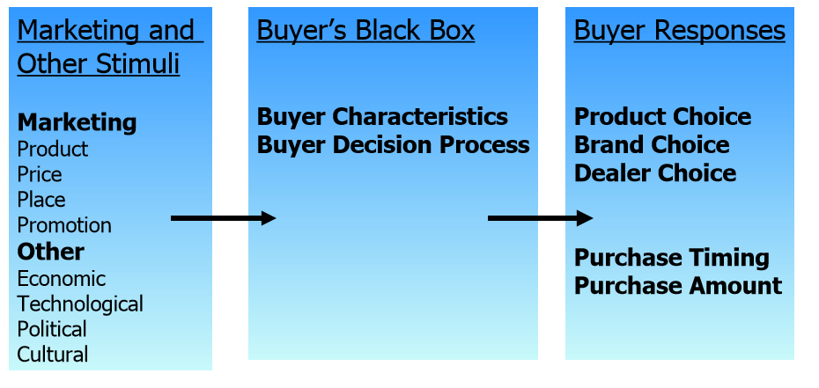
Lawson’s model (Model of Buyer Behavior )

Slide 16
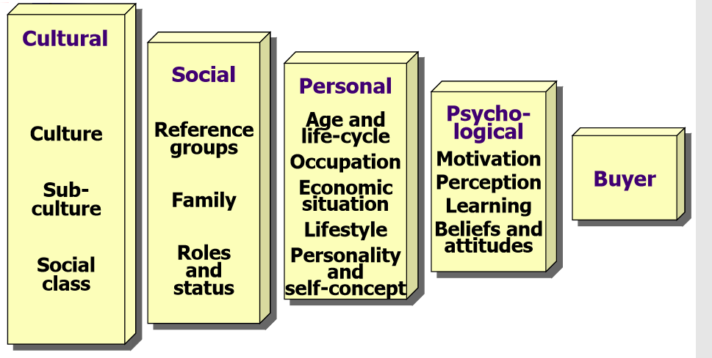
Lawson’s model (Factors Influencing Consumer Behavior)

Slide 17
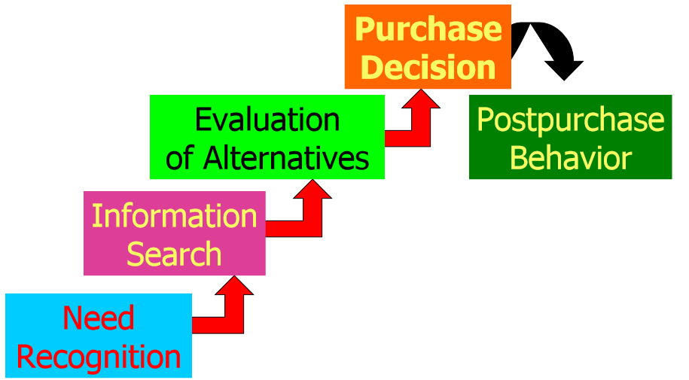
Lawson’s model (Buyer Decision Process )

Slide 18
The Engel Kollat Blackwell (EKB) model
The EKB model of consumer behavior was originally designed to serve as framework for organizing the fast growing body of knowledge concerning consumer behavior.
This model talks of consumer behavior as a decision making process in the form of steps (activities) and other related variables which occur over a period of time.
Essentially this is a conscious problem solving and learning model of consumer behavior.

Slide 19
EKB model continue ...
This model talks about consumer behavior as a decision making process in the form of five steps (activities) and other related variables which occur over a period of time.
5 steps involved in the decision making process:
Problem Recognition.
Information Search.
Alternative Evaluation.
Choice.
Outcome.

Slide 20
Other related Variables included in this model
Information input.
Information processing.
Product – brand evaluation.
General motivating influences.
Internationalised environment influence.

Slide 21
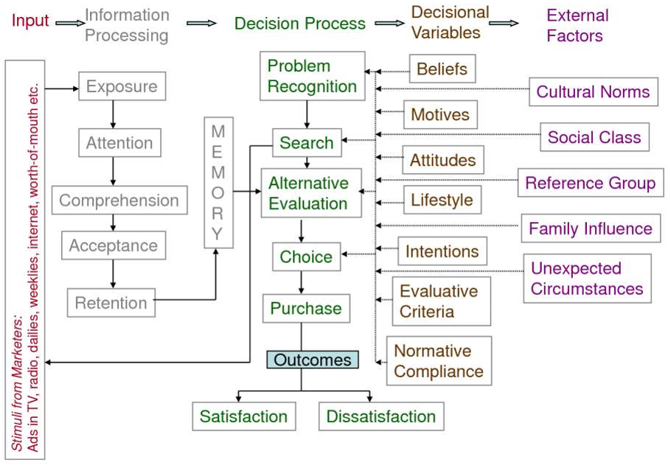
The Model

Slide 22
About the Model
The model has emphasized on the conscious decision making process adopted by a consumer.
The model is easy to understand and is flexible.
This model recognizes that a consumer may not go through all the steps always. This is because in case of repeat purchases the consumer may bypass some of the steps.
One limitation, the inclusion of environmental variables and general motivating influences but not specifying the effect of these on the buyer behavior.

Slide 23
Howard and Sheth models
The Howard Sheth Model is an approach for analyzing the combined impact of the social, psychological and marketing factors on the buying behavior or preference of the consumers and the industrial buyers into a logical order of information processing.

Slide 24
Three Levels of Decision-Making in Howard Sheth Model
Extensive Problem Solving: This is the initial stage of decision-making, where the buyer is new to the market. He/she has no or little information about the brands and has no preference for a particular product or service.
Thus, a consumer is an information seeker at this level, who check out different brands available in the market, before making a buying decision.

Slide 25
Three Levels of Decision-Making in Howard Sheth Model
Limited Problem Solving: At this level, the buyer has inadequate or incomplete information about the product, market or the brands operating in it. Sometimes the buyer is confused among the various alternatives.
Therefore, to make a buying decision, he/she look for a comparative study of the different brands and the products available in the market.

Slide 26
Three Levels of Decision-Making in Howard Sheth Model
Routinized Response Behaviour: The habitual response behavior stage is where the buyer is entirely aware of the products offered by different brands and the features, pros and cons of each product.
He/she is capable of evaluating and comparing the multiple options available in the market.
Here, the buyer decides in advance, which product is to be purchased.

Slide 27
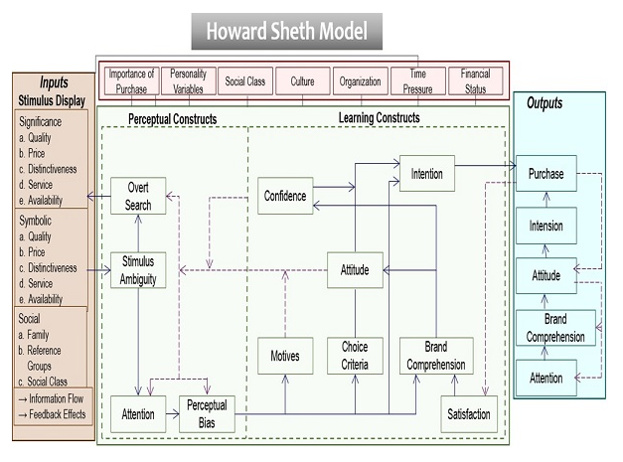
The Model

Slide 28
Input Variables
Significant Stimuli: The significant stimuli are the physical traits of the product and the brand. It includes the product’s price, quality, availability, distinctive characteristics and service.
Symbolic Stimuli: The marketing strategies like advertisement and publicity creates a psychological impact on the buyer’s perception of a product’s rhetorical and visible features.
Social Stimuli: The social stimuli comprises of the various environmental factors which are considered as a source of information for the buyers. It includes family, social class and reference groups.

Slide 29
Perceptual Constructs
Sensitivity to Information: The buyer’s level of understanding or openness towards the information received by him/her.
Perceptual Bias: On the grounds of individual perception of each brand, the buyer is partial towards a particular brand.
Search for Information: The buyer also seeks for more information to ensure the right decision-making.

Slide 30
Learning Constructs
Motive: The specific goal or purpose for which the product purchase is carried out.
Choice Criteria: The set of principles or benchmarks defined for product selection.
Brand Comprehension: The information about the product or brand pertained by the buyer.
Attitude: The buyer’s perspective and willingness to purchase a product of a particular brand defines his/her attitude.
Confidence: The trust or faith of the buyer in a specific brand and its products builds his/her confidence.
Intention: The buyer’s purchase motive, preference criteria, brand comprehension, consumer attitude and confidence, results in the selection of a particular brand.
Satisfaction: After-purchase, the buyer evaluates his/her level of contentment, to find out whether the product has fulfilled the expectations or not.

Slide 31
Output Variables
Attention: The buyer’s level of concentration and alertness with which he/she understands the information provided, is termed as attention.
Brand Comprehension: The awareness of the buyer regarding a particular brand and its products is known as brand comprehension.
Attitude: The buyer’s evaluation of a brand in terms of individual likes and dislikes, determines his/her behavior, interest and awareness towards it.
Intention: The aim or objective of the buyer for purchasing a product can be seen as the buying intention.
Purchase Behavior: All the above elements result in the actual purchase of a product by the buyer.

Slide 32
Exogenous Variable
Importance of Purchase: If the buyer perceives the product to be less crucial, involving a low cost, then there is a little brand preference.
Personality Variables: Personal traits like ego, self-esteem, anxiety, dominance, authoritarian, etc. influences a buyer’s decision-making while purchasing a product.
Social Class: A buyer’s social group, including the family, friends and other reference groups impact the selection or rejection of a particular brand.
Culture: The buyer’s values, beliefs and ideas frame his/her purchase motive and inhibitors.
Organization: The buyer’s interaction with the social groups define their authority, status and power. The hypothetical constructs of a buyer are affected by such formal or informal communications.
Time Pressure: The buyer, at times, is under the pressure of taking a timely decision, which makes him/her look for alternatives if the product of the preferred brand is unavailable at the moment.
Financial Status: The buyer’s inability to purchase a product or unaffordability restricts him/her from buying it.

